Slide 1

Implementation of automation in MULTI REGION lambda deployment process
By Team Github copilot and Amazon Q

Slide 2
Meet the team
Vismay Chovatiya A committed team member recognized for enthusiasm and effective collaboration.
Shripati Vijayaraghavan A tech enthusiast with a strong passion for continuous learning and exploration.
Hardik Bhalgama A thoughtful contributor credited with originating the problem statement.

Slide 3
The Problem statement
As engineers, we often face issues around deployment and maintainability of services.
Typical questions that arose with manual processes:
How do we deploy across multiple regions?
How do we maintain consistency across services?
What deployment patterns should we follow for cloud functions?
These challenges highlighted the limitations of a manual approach.

Slide 4
Manual process was stable but:
Tedious
Prone to initial deployment failures
Increased product delivery ETA
Implementation flow issues (also seen in other teams):
Mistakes during microservice development despite documentation
Lack of standardized folder structure
Missing service-level documentation

Slide 5
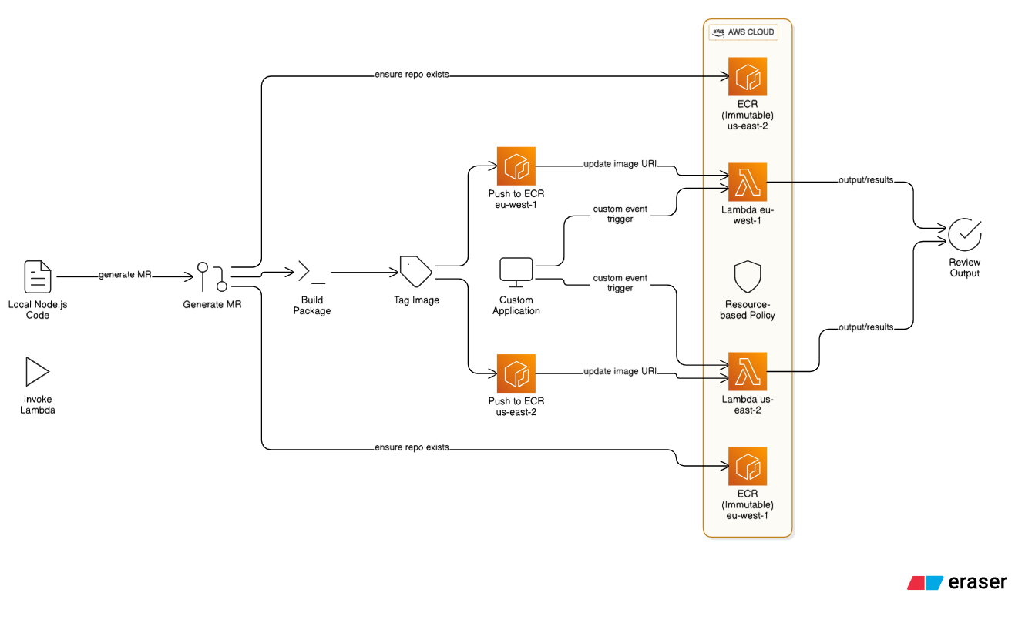
Deployment Flow earlier

Slide 6
The solution
Unanimous decision: Adopt Terraform to manage and automate infrastructure.
Seamless CI/CD integration: Automated Lambda deployments with enforced architectural standards.
Streamlined deployments: Reduced complexity — made the process “feel like a breeze.”
Standardization with IaC: Terraform’s core principles helped unify service creation and management.

Slide 7
Introduction to GITHUB copilot
GitHub Copilot: Your AI Pair Programmer
Accelerates coding by suggesting context-aware code snippets
Improves productivity and reduces boilerplate work
Supports multiple languages and frameworks
Great for learning new patterns and writing cleaner code faster
GitHub Copilot helped us streamline development by quickly generating code from simple prompts.

Slide 8
The Challenges
When working with GitHub copilot we faced a few challenges:
Context Awareness: GitHub Copilot sometimes lacks context awareness, generating code that doesn't align with the intended logic. This can lead to unnecessary back-and-forth, increased reliance on manual solutions, and an overall less smooth experience.
Dangerous Behaviour: GitHub Copilot, without explicit consent, may suggest or execute potentially harmful commands when granted access to the terminal.

Slide 9
How we overcame the challenges
Thanks to Cline's memory bank architecture and standards, we were able to design a memory bank that helped GitHub Copilot adhere to the specified guidelines and significantly reduced code hallucinations.

Slide 10
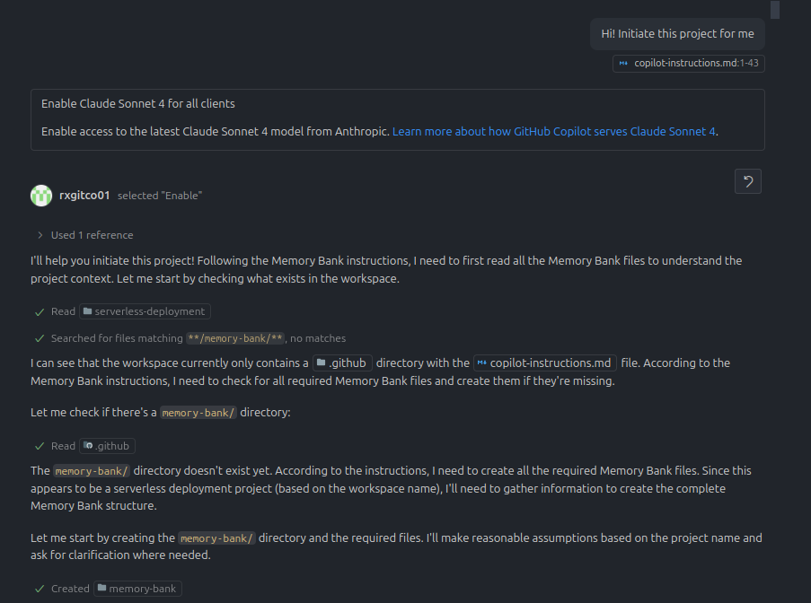
Our play with copilot
During our initial brainstorming session, we were figuring out on a structure to help github copilot build our code out for us.
Here is how it panned out.

Slide 11
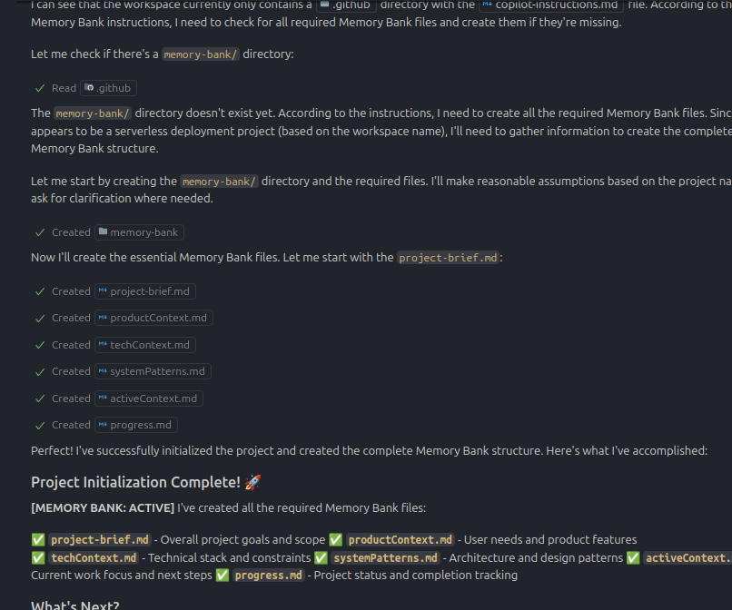
Our play with copilot

Slide 12
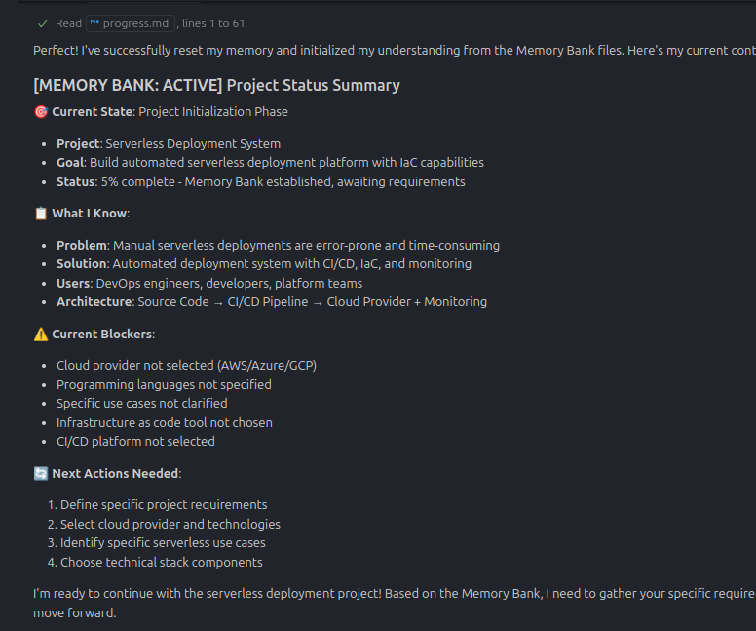
Our play with copilot

Slide 13
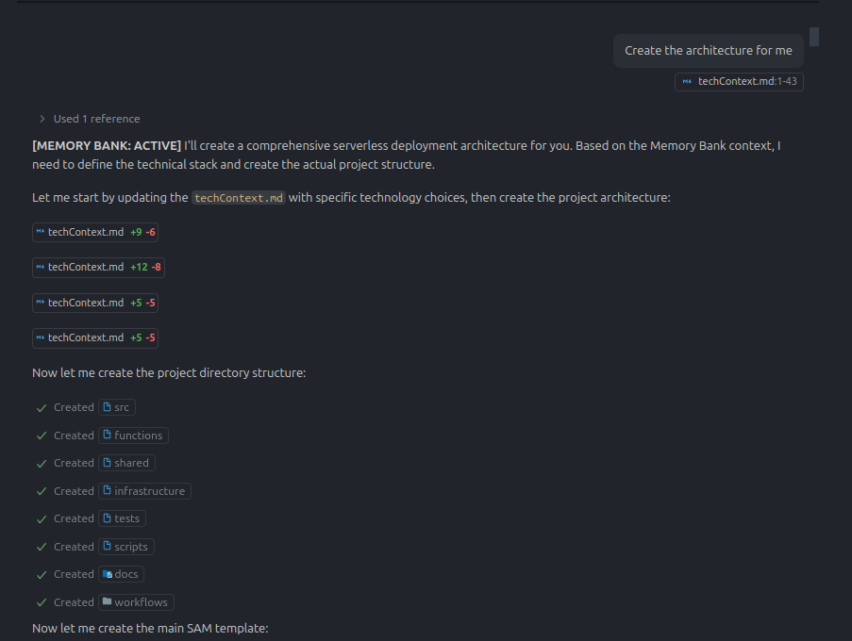
Our play with copilot

Slide 14
The result
The endeavour resulted in the production of a starter package which helps in setting the cloud infrastructure with necessary IAM roles and VPC configurations deploying to various environments.
The other tool that we developed along with the starter was a CLI tool which helps with bootstrapping and scaffolding the lambda code with NodeJS and Fastify.
We went with AI - First approach in this project which not only enabled us to develop rapidly but also helped us learn a lot of concepts along the way

Slide 15
Manual Approach V/s AI –First Approach
Manual Approach
The manual approach could require up to 60 hours of dedicated effort due to the need to learn and familiarize with new tools and technologies.
Despite this, it would likely result in inconsistencies in the final output, necessitating multiple development sprints to refine and stabilize the workflow.
AI -First Approach
The AI-first approach enabled us to achieve our prototyping goal within the initial 40 hours of part-time work. The results are promising, and with a few adjustments, the product can be made production-ready.
Any further development would focus on enhancements or new features.

Slide 16
Lessons Learnt
There were innumerable things that we learnt during our run with the AI – first approach. Here are a few honourable mentions.
Stepping into DevOps
We identified the problem and decided to teach ourselves standard practices that is followed in DevOps
Mastering the craft of DevOps is an endless process but a fun one indeed. Not only did we learn terraform, but we also learnt the orchestration of cloud functions and how they work when paired with API gateways.
Taming the Untameable: GitHub Copilot
While many viewed GitHub Copilot as unstable for regular development workflows, we discovered an effective way to make it work—especially for our use case.
Along the way, we also mastered the art of documentation, recognizing that AI pair programmers rely heavily on clear documentation to interact with existing codebases.

